Slide 1

Module 6:
Stealing
Knowledge and
Morality

Slide 2
Review – Worldview categories
All is material (material ist)
Material + immaterial (dual ist)
Multiple gods (poly theism)
One God (mono theism)

Slide 3
How do we
Know
What we know?

Slide 4
The Source of All Knowledge
Proverbs 1:
7. the Fear of the Lord is the beginning of knowledge; fools despise wisdom and instruction.
20. Wisdom cries aloud in the street,
in the markets she raises her voice;
(when problems come...)
28. Then they will call upon me, but I will not answer; they will seek me diligently but will not find me.
29. Because they hated knowledge
and did not choose the fear of the LORD,
Notes:
-All true knowledge is in Christ.
-If you trust man-based knowledge and ways of thinking, you'll be robbed of true knowledge
And become futile in your reasoning as Romans 1:21 says.
Jesus said he is the way, the truth, and the life.
God has a monopoly on knowledge.
To deny the Christian God is to hate the source of the ability to know anything, which is to hate knowledge.

Slide 5

Denying God as the authority for truth results in foolish thinking and means you
hate knowledge.
What is the Christian's
source of knowledge?...
Notes:
-All true knowledge is in Christ.
-If you trust man-based knowledge and ways of thinking, you'll be robbed of true knowledge
And become futile in your reasoning as Romans 1:21 says.
Jesus said he is the way, the truth, and the life.
God has a monopoly on knowledge.
To deny the Christian God is to hate the source of the ability to know anything, which is to hate knowledge.

Slide 6

If I told you
I had the winning lottery ticket
When it's randomly picked
And I win it tomorrow
It was a lucky guess
-I didn't really know
-It was a true belief
But was not justified
Knowledge is justified, true belief

Slide 7


The Christian's source of knowledge
Colossians 2:1-3
v.1 For I want you to know how great a struggle I have for you and for those at Laodicea and for all who have not seen me face to face,
v.2 that their hearts may be encouraged, being knit together in love, to reach all the riches of full assurance of understanding and the knowledge of God’s mystery, which is Christ,
v.3 in whom are hidden all the treasures of wisdom and knowledge.
Notes:
In Collossians 2, Paul is addressing people who claim to have secret knowledge, so Paul tells then where true knowledge can be found
-Jesus is the authority for truth, not people
Vs 4.
Do people sometimes find false arguments to be persuasive?
We need look no further than politicians or lawyers for examples.
Something may be emotionally appealing, but is it true?

Slide 8

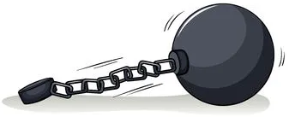
Colossians 2
v.4 I say this so that no one will deceive (rob) you with persuasive arguments.
v.6 Therefore, as you received Christ Jesus the Lord, so walk in him,
v.8 See to it that no one takes you captive by philosophy and empty deceit, according to human tradition, according to the elemental spirits of the world, and not according to Christ.
Notes:
In Collossians 2, Paul is addressing people who claim to have secret knowledge, so Paul tells then where true knowledge can be found
-Jesus is the authority for truth, not people
Vs 4.
Do people sometimes find false arguments to be persuasive?
We need look no further than politicians or lawyers for examples.
Something may be emotionally appealing, but is it true?

Slide 9

What are the two basic assumptions of the Christian worldview?
1. The Christian God is our ultimate authority
2. How do we know?
God revealed Himself

Slide 10



What is Morality?
Expectations
how we 'ought' to behave
how things 'should' be

Slide 11
Do people act as if
There are some things that are wrong
Regardless of anyone's opinion?
Yes
Examples:
-Don't lie to me
-Don't steal my stuff

Slide 12
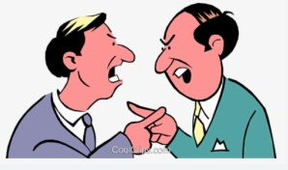
Can people be the source of truth in morality?
No
Because humans constantly
disagree
Can't get
consistent
From
inconsistent

Slide 13

Morality...
Without an unchanging moral standard,
1.) You could not promote Martin Luther King
2.) You could not condemn Hitler
You could only say
they were
different.

Slide 14
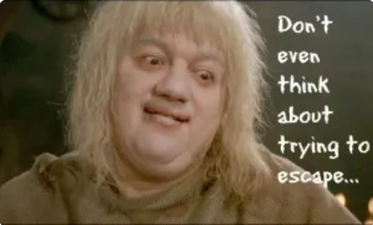
This is the pit of despair
That the unbeliever is logically brought to if he truly lived out his beliefs
But no one lives like that

Slide 15
Why does the Christian
Believe truth in morality can be known
Even though people disagree?

Slide 16

Because the Christian God
Is the unchanging, universal, and eternal source for moral values
Only the Christian worldview
Gives a good reason to condemn racism, murder, torturing babies for fun, and give you human dignity.

Slide 17
Find a way to make it personal
So that the unbeliever
Can feel the weight
Of his own worldview
Collapsing on itself

Slide 18
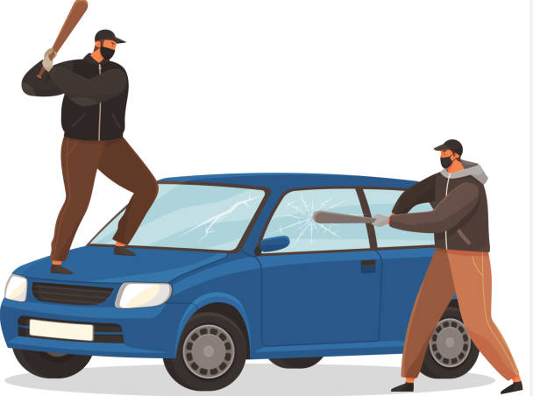
All unbelievers live as if truth in morality exists
A Scenario:
-Thugs bash your window in
-Take your stuff
-say you deserve it
-call you an oppressor
By what standard
will the unbeliever
condemn the thugs?
Will he say
It is my opinion that you should STOP!
Of course. As an imager of God, humans
cannot help but perceive God's invisible
attributes

Slide 19

What you'll hear...
I don't care what's right or wrong
Let's do whatever fixes problems.
Pragmatism starts with
an ethic (moral ought)
But has no good reason
why we ought to follow it

Slide 20
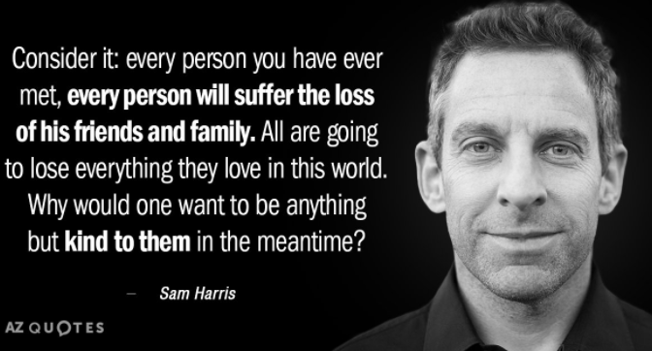
What is it the "ethic" here?
Notes:
What is kindness?
By what standard?
Your opinon?
The child predator has a different standard.
People disagree

Slide 21

Why it's wrong
You only have a good reason to be kind to others within the Christian worldview
His reason is "it is my opinion"
that you should be kind.
Why does he not
have a good reason
to condemn
the child predator
who disagrees with his ethic
about being kind to children?
Notes:
Because it's just his opinion.
We are sure he has lots of opinions here.
A broken clock is right twice a day; he could be right, but how does he know?

Slide 22
God is clearly percieved (Romans 1:20)
The Christian God is necessary for:
- Logic, Morality, Choice, human dignity, etc...
We depend on these invisible attributes of God which are are clearly perceived
These are daily gifts from God yet the unregenerate "neither glorified God nor gave thanks" (Romans 1:21)

Slide 23
Comprehension Questions
Why are humans not able to be the source of moral oughts?
Is there an unchanging standard for moral oughts?
How do we get the unbeliver to realize he really does believe truth in morality exists?
Notes:
-human opinions on moral oughts constantly change and differ
-Yes, the nature* of the Christian God
-Ask them about a moral ought they strongly believe is true regardless of anyone's opinion
(ie. Child predator)

Slide 24

The source of all knowledge
Demonstrated the absurdity of truth in morality
without the Christian God

Slide 25
Worldview Review
What are the main 4 worldview categories?
Notes:
Materialism
Dualism
Polytheism
Monotheism

Slide 26





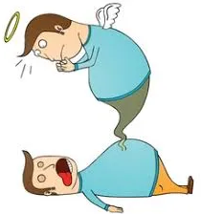








Review – 4 Worldviews
Materialist
Dualist
Polytheism
Monotheism
Notes:
Why won't these work?
1.)Atomism: time + chance, acting on matter.
Atoms can't be universal, constantly change.
Logic is universal and unchanging.
Atoms insufficient as source of moralsm, choice, and logic.
We all hold others to moral standards. No one lives as if atheism is true.
2.)Confucious say? That's his opinion.
The Christian God knows everything. He doesn't
3.)Multiple gods means competing sources of authority, destroying the possibility of unchanging universals such as logic or truth in morality.
Also, how was it revealed?
Able to create life and the universe?
4.)The other Abrahamic religions depend on Christianity and contradict on their own standards.
-Others: can their deity support universals? Creation? Human nature, value

Slide 27

Next Module:
How to refute the Dualism worldview

Slide 28

End of Module 6
Questions?

